Slide 1
METS, Standards and Rights METS, Safonau a Hawliau
Vicky Phillips
Digital Standards Manager
Rheolwr Safonau Digidol
4th March 2014 4^{ydd} Mawrth 2014

Slide 2
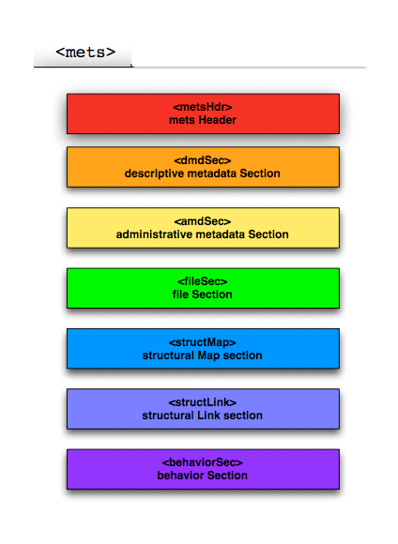
METS Metadata Encoding & Transmission Standard
Descriptive, administrative and structural metadata
XML schema language
Management and use of digital objects
7 sections

Slide 3
Standards used in NLW
METS - Metadata Encoding & Transmission Standard, wrapper for all other metadata
MODS - Metadata Object Description Schema, bibliographic information, VIRTUA, Wombat
DC – Dublin Core, OAI-PMH, Fedora
PREMIS – Preservation Metadata to ensure their long term usability, 5 entities Object, Event, Agent, Rights and Intellectual Entities
MIX – Metadata for Images in XML Schema, JHove (identify, validate, characterization), Benchmarking document
TextMD – Technical Metadata for Text, detailing properties e.g. language, font
EAD – Encoded Archival Description, Fonds Level METS, WW1, VTLS Script
TEI – Text Encoding Initiative, standard for representation of texts in digital form
ALTO – Analyzed Layout and Text Object, tech metadata for OCR, used in SCIF Newspapers

Slide 4
METS Levels and Templates
Levels – single level (photo), multi level (newspaper)
Source data – Wombat, Legacy METS, VIRTUA, JHove
XSLT
Developing generic templates
Title
Issue 1
Page 1
Page 2
Issue 2
Page 1

Slide 5
Rights
2 types – Copyright (user), PREMIS (repository)
Pre / Post ingest
Excel
XSLT
Script to add to ingested METS
Notes:
There are two types of Rights – Copyright rights which informs the user on how they are able to use the digital object. We used to use METSRights to hold this information but with the move towards Creative Commons we now hold this information in the Creative Commons RDF. PREMIS rights is the rights we have been given as digital repository in order to preserve the object for the long-term.
Before WW1 project most projects were collections where the Rights were the same across the whole collection and were therefore included in the METS templates. However in WW1 project material had different rights and wasn’t all finalised prior to ingest. We therefore devised a way in which to add the rights post ingest. We did this by creating an Excel table which could be populated by Dafydd Tudur and/or Metadata Unit, creating an xslt in order to convert this Excel data to XML ready for inclusion in the METS and then a script for adding this to correct METS.

Slide 6
vicky.phillips@llgc.org.uk
ext. 925

