Slide 1
Ingest
Glen Robson gmr@llgc.org.uk
Ioan Issac-Richards iir@llgc.org.uk
Vicky Philips tvf@llgc.org.uk

Slide 2
Ingest Workflow
Wombat
Wombat
To
METS
Add Jhove to METS
Validation
Ingest
MARC Data

Slide 3
Wombat Workflows
General – classic workflow
Wills
WJO – for Ccymod project
SCIF Journals
SCIF Newspapers
WW1 Archival

Slide 4
General
Parent
(Manuscript)
LCN at phase level
LCN = MARC record
Manuscripts
Books
Maps
Photo Albums
Ingest at Phase level
Child
(Manuscript Page)
Child
(Manuscript Page)
Child
(Manuscript Page)
Child
(Manuscript Page)

Slide 5
Wills Workflow
LCN per item or multiple items per LCN
Photographs
Wills
Paintings
Postcards
Could do the same with General but lots of phases
Ingest at phase level
Parent
(Postcard Record)
Parent
(Photograph)
Child
(Front)
Child
(Back)
Child
(Image)

Slide 6
WJO Ccymod Workflow
Used for Ccymod project
Requires a separate Flam database
Not using any more

Slide 7
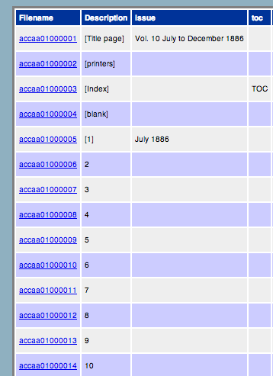
SCIF Journals
LCN at Project Level / Title
Title
(Project)
Contains Phases
Child
(Issue)
Child
(Issue)
Child
(Page)
Child
(Page)

Slide 8
SCIF Journals
Only used for Journals so far
Could be used for Books with a phase being a Book and a issue is a chapter.
Manages ingest:

Slide 9
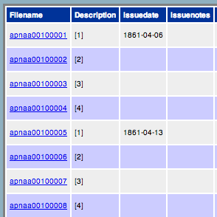
SCIF Newspapers
LCN at Project Level / Title
Title
(Project)
Contains Phases
Child
(Issue)
Child
(Issue)
Child
(Page)
Child
(Page)

Slide 10
SCIF Newspapers
Only used for Newspapers
Manages Ingest

Slide 11
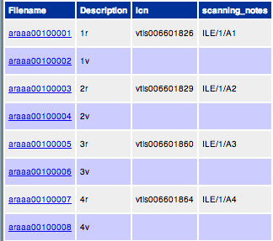
WW1 Archives
Project = Archive (LCN)
Phase = Box. Box contains archival Files
Files (LCN) contain Pages
Pages

Slide 12
WW1 Archives
Archive
(Project)
Contains Phases
Archive contains:
EAD
File contains
MARC for file
Child
(File)
Child
(File)
Child
(Page)
Child
(Page)

Slide 13
Newspaper Export
https://trac.llgc.org.uk/projects/scif/attachment/ticket/440/accac001.xml

Slide 14
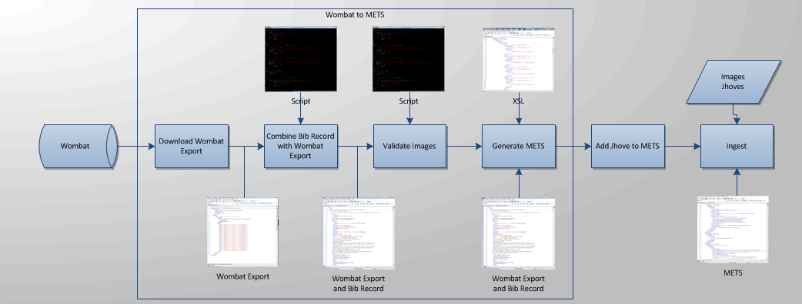
Getting Files Ready for Ingest

Slide 15
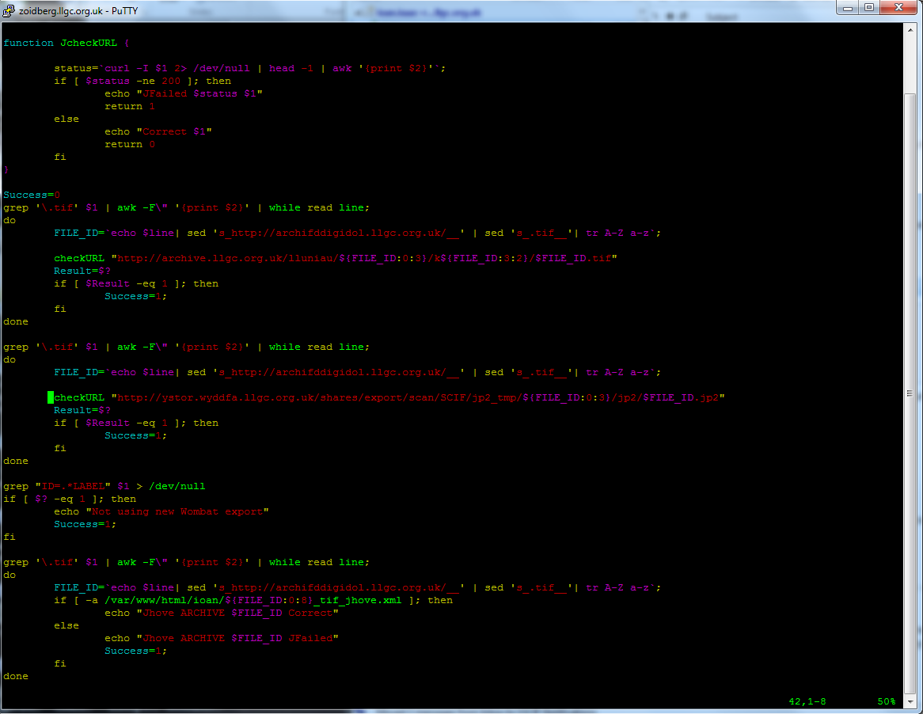
Script
Classic Storage Layout

Slide 16
Wombat Export
Wombat Export & Bib Record

Slide 17
XSL
METS

Slide 18
Jhove
Developed by Harvard
Format Validation
Empty tiffs
Corrupted tiffs
Invalid tiffs
Invalid headers (scanner fix)
Java couldn’t open which meant PDFs couldn’t be generated
Format version
Metadata
Tries to replace the legacy technical data (dc)
Like to capture which scanner was used
Anything it doesn’t catch we put in the Benchmarking
Checksums
http://ystor.llgc.org.uk/shares/export/scanning/manuscripts/metadata/arg/jhove/tiff_jhove/arg10101_tiff_jhove.xml

Slide 19
Validation
Images in Archive
Images are web accessible
METS is valid
MIX present

Slide 20
Ingest
Manuscript
http://dams.llgc.org.uk:8080/fedora/objects/llgc-id:3435811
Page
http://dams.llgc.org.uk:8080/fedora/objects/llgc-id:3435863
Plus 71 more pages

Slide 21
Ingest
Ingest is:
Converting METS to FOXML
Sending FOXML to Fedora
http://zoidberg.llgc.org.uk/gmr/llgc-id_3435811.xml
Parent
(Manuscript)
METS
Parent
(Manuscript)
FOXML
Fedora/VITAL
Child
(Manuscript Page)
METS
Child
(Manuscript Page)
FOXML

Slide 22
Access
Parent
(Manuscript)
METS
SOLR
Indexing
Fedora/VITAL
Child
(Manuscript Page)
METS
Website Image Access

Slide 23
Access Website
Catalogue
Wills
Ballads
Images – Geoff Charles, John Thomas, Tirlun Cymru etc
Offair Recording
Drawing Volumes
Journals
Welshjournals.llgc.org.uk
Newspapers
Welshnewspapers.llgc.org.uk
WW1
Cymru1914.org
Europeana
http://www.europeana.eu/portal/record/9200118/52F6D985A640F2A42360043B56B8DD445675D3F1.html
Peoples Collection
http://www.peoplescollection.co.uk/Item/15173-tankereys-house-llangollen
Full List:
http://dev.llgc.org.uk/wiki/index.php?title=Example_Collections

