Slide 1
Archivematica and NLW
Glen Robson
Head of Systems Unit
National Library of Wales

Slide 2
Plan
What do we use Archivematica for?
Background to our repository
Other ingest pipelines
What we require for ingest
Case study – single PDF
Catalogue in Virtua
Taking through Archivematica
DIP & AIP
Conversion to NLW METS
Ingest
Add holdings to Catalogue
Issues uncovered
Technical metadata about Archive version
AIP and DIP need bits from both

Slide 3
Background to our Repository
VITAL product from VTLS based on Fedora
3,907,387 objects
Mostly digitised content
Wills, Photographs, Maps, Journals, Newspapers and Archives
Some born digital content:
Electronic Thesis
Offair TV & Radio recordings
Multiple interfaces:
http://cat.llgc.org.uk/
http://welshjournals.llgc.org.uk/
http://welshnewspapers.llgc.org.uk/
http://cymru1914.org/

Slide 5
Ingest Pipelines 1
Digitised Content
Wombat
Structural Information
Fedora/VITAL
NLW developed Ingest Tools
Virtua
Descriptive Information
Jhove
Technical Metadata

Slide 6
Ingest Pipeline 2
Offair Content
Fedora/VITAL
Bob Digital Video Recorder
Structural Information
Descriptive Information
NLW developed Ingest Tools
Creates Record
Media Info
Technical Metadata
Virtua
Descriptive Information

Slide 7
Ingest Pipeline 3
Electronic Thesis
Harvest from University
Structural Information
Descriptive Information
Fedora/VITAL
NLW developed Ingest Tools
Creates Record
DROID
Technical Metadata
Virus Check
Technical Metadata
Virtua
Descriptive Information

Slide 8
Common Themes
Structural Information
Descriptive Information
Technical Metadata

Slide 9
What Archivematica gives us
Structural Information
Structural information
METS
Packages
Descriptive Information
Link to Virtua through dc:identifier
Technical Metadata
Droid, jhove and Virus Check
Descriptive Information
Technical Metadata

Slide 10
Case Study Single PDF

Slide 12
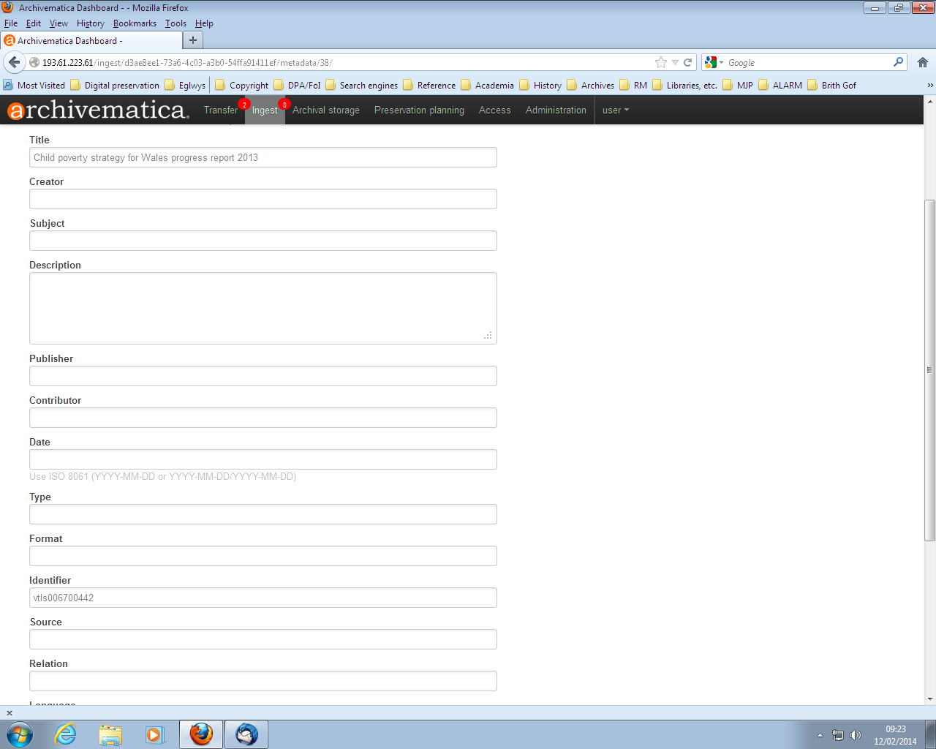
Link to Catalogue Record

Slide 13
Results
AIP:
/var/archivematica/sharedDirectory/www/AIPsStore/d3ae/8ee1/73a6/4c03/a3b0/54ff/a914/11ef/Child_Poverty_Strategy-d3ae8ee1-73a6-4c03-a3b0-54ffa91411ef.7z
Original File
Archive File
METS
DIP:
/var/archivematica/sharedDirectory/watchedDirectories/uploadedDIPs/Child_Poverty_Strategy-d3ae8ee1-73a6-4c03-a3b0-54ffa91411ef
Access File

Slide 14
Conversion to NLW METS & Ingest
AIP
Fedora/VITAL
DIP
NLW
SIP
Virtua
Descriptive Information

Slide 15
Notes:
Search for child poverty strategy for wales

Slide 16
Issues
For the PDF example three versions were created:
Access – PDF
Original – PDF
Archival – PDF/A
Traditionally we store technical data about the Archive version but in Archivematica there is more on the Original

Slide 17
Two Zip files
AIP:
/var/archivematica/sharedDirectory/www/AIPsStore/d3ae/8ee1/73a6/4c03/a3b0/54ff/a914/11ef/Child_Poverty_Strategy-d3ae8ee1-73a6-4c03-a3b0-54ffa91411ef.7z
Original File
Archive File
METS
DIP:
/var/archivematica/sharedDirectory/watchedDirectories/uploadedDIPs/Child_Poverty_Strategy-d3ae8ee1-73a6-4c03-a3b0-54ffa91411ef
Access File

Slide 18
Future
Multiple files per submission
Digital Archives
Personal
Institution
Archives that arrive in multiple batches

Slide 19
Questions
glen.robson@llgc.org.uk

