Slide 1
Archivematica, NLW & ARCW
Glen Robson
Head of Systems Unit
@glenrobson

Slide 2
ARCW
Archives Record Council Wales (ARCW)
13 Local government archive services
5 university archives services
4 national institutions
Coalition of the Willing (COW)
Established in 2009
Looking at systems and techniques for digital preservation support the Welsh Institutions
Supported by the Welsh Government

Slide 3
ARCW Investigations
Evaluated difference Open Source Solutions
The Dark Archive In The Sunshine State
Islandora
DPSP/Xena
Archivematica
Tested Archivematica
Paul James – install, training and evaluating
Paid for development to arrange archives in Archivematica (1.4)
Preservica
Testing a hosted Preservica instance
Testing hosting of Archivematica by Arkivum
Financially sustainable
Software hosted not supported – maybe a support contract with Artefactual
Atom and Archivematica

Slide 4
NLW & Archivematica
No workflow for born digital
Investigated RODA
Difficult to install
No community
Collections
Government Publications
Personal Archives
Public Sector Archives

Slide 5
Current Infrastructure
Catalogue – Virtua
Archives catalogued in Hierarchical MARC records
Can be exported as EAD
Digital items catalogued in MARC
Repository – Fedora 3.3
Overwhelmingly Digitised Items (over 4 million items)
Links to preservation files (tiff)
Stores Metadata (METS)
Stores reference files for display
Structures information in objects

Slide 6
What Archivematica gives us
Structural information
METS
Packages
Descriptive Information
Link to Virtua through
dc:identifier
Technical Metadata
Droid, jhove and Virus Check
Structural Information
Descriptive Information
Technical Metadata

Slide 7
Case Study Single PDF

Slide 9
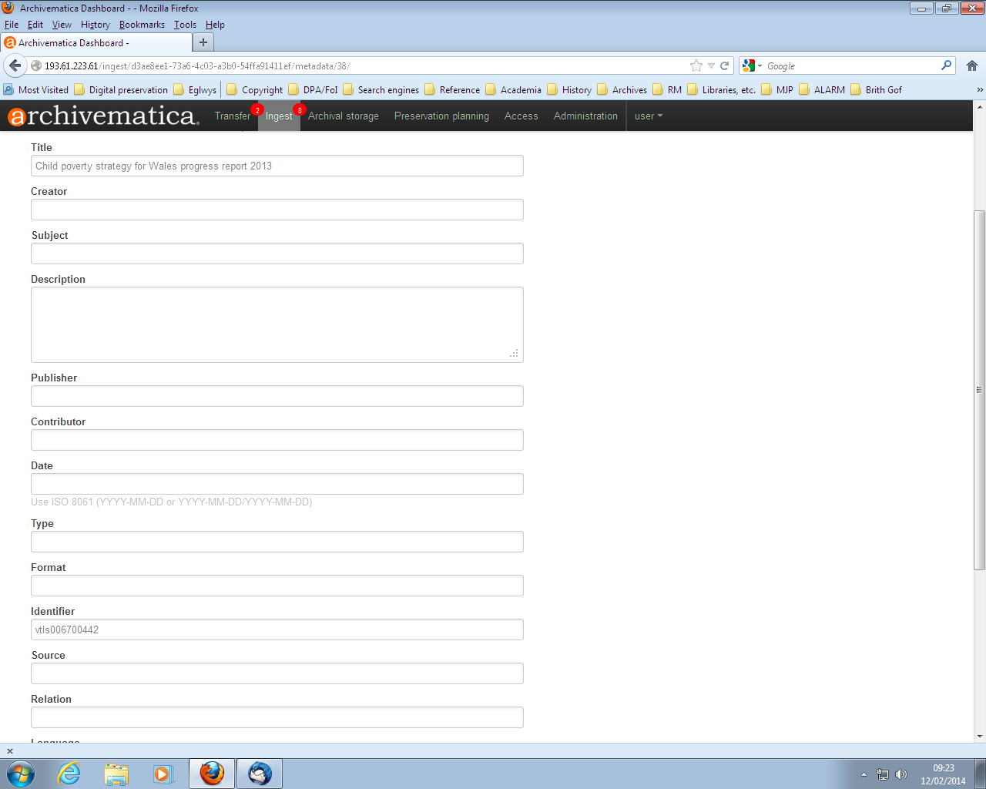
Link to Catalogue Record

Slide 10
Results
AIP:
/var/archivematica/sharedDirectory/www/AIPsStore/d3ae/8ee1/73a6/4c03/a3b0/54ff/a914/11ef/Child_Poverty_Strategy-d3ae8ee1-73a6-4c03-a3b0-54ffa91411ef.7z
Original File
Archive File
METS
DIP:
/var/archivematica/sharedDirectory/watchedDirectories/uploadedDIPs/Child_Poverty_Strategy-d3ae8ee1-73a6-4c03-a3b0-54ffa91411ef
Access File

Slide 11
Conversion to NLW METS & Ingest
AIP
Fedora/VITAL
NLW
SIP
Virtua
Descriptive Information

Slide 12
Notes:
Search for child poverty strategy for wales

Slide 13
Issues
For the PDF example three versions were created:
Access – PDF
Original – PDF
Archival – PDF/A
Traditionally we store technical data about the Archive version but in Archivematica there is more on the Original
We store AIP and DIP in one system. AIP is part of access.

Slide 14
New Workflow
Custom SWORD server
Apache Camel Workflow
AIP
Storage Service
Fedora
SWORD
Submit to Atom
Retrieve AIP
Expand AIP
Droid
JHove
NLW
SIP
Virtua
Descriptive Information

Slide 15
The Future
Finish ingest workflow
Moving to Alma & PRIMO
Investigating for both Digital and Traditional:
ATOM
ArchiveSpace
CALM
Very interested in what others are using
For both digital and traditional archives.

